Slide 1
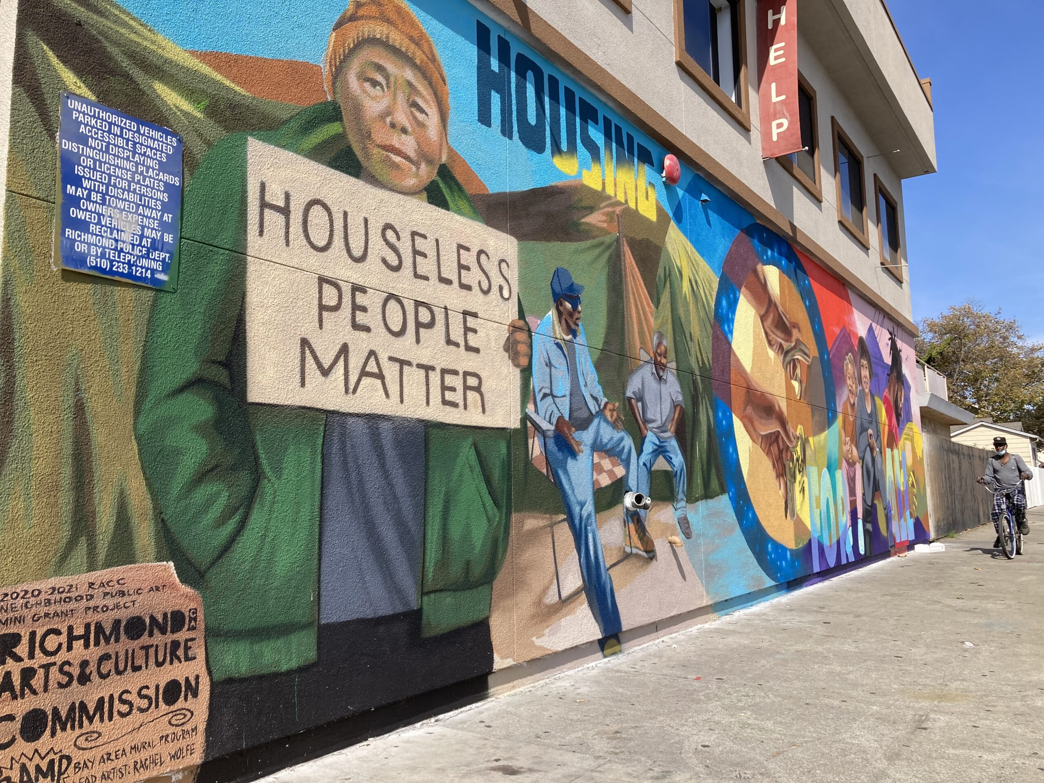
GRIP The Greater Richmond Interfaith Program also known as The Souper Center
2024 MEDIA KIT

Slide 2
GENERAL
NAME: Greater Richmond Interfaith Program
SECOND REFERENCE: GRIP (all capitalized)
MISSION STATEMENT: “GRIP provides a safe & nourishing place that helps transform those who are unsheltered and in need move toward self-sufficiency.”
LOCATION: 165 22nd Street, Richmond, California 94801
PHONE: (510) 233-2141
EMAIL: info@gripcommunity.org
LOGO: https://gripcares.org/wp-content/uploads/2023/06/grip-logo.jpg
WEBSITE: https://gripcares.org/
TAX INFORMATION: GRIP is a registered 501(c)(3) tax-exempt organization.
Federal Identification Number: 23-7169239
GOOGLE MY BUSINESS: https://goo.gl/maps/snoWduddbf9Bu5A97
FACEBOOK: https://www.facebook.com/GRIPCares
INSTAGRAM: https://www.instagram.com/grip.cares/
TWITTER: https://twitter.com/gripcares
LINKEDIN: https://www.linkedin.com/company/greater-richmond-interfaith-program/
RSS: https://gripcares.org/feed/

Slide 3
GRIP Imagery: GRIP’s brand is signified by its “hands” logo and its new mural
The mural, commissioned by Richmond’s Love Your Neighbor Block Grant program in 2021, features a colorful view of hope. The artists from the Bay Area Mural Program included the story of Najee Harris who lived here as a kid before going on to become an NFL star.
Blue: #112530
Orange: #9B5706
Beige: #F5E9BF

Slide 4
ABOUT GRIP
GRIP is a multi-cultural, multi-ethnic coalition of congregations from varied faiths working together as a diverse and inclusive coalition dedicated to helping those of our community in need to transition to self-sufficiency.
Our mission statement: “GRIP provides a safe & nourishing place that helps transform those who are unsheltered and in need move toward self-sufficiency.”
Over the years, GRIP, in keeping with its mission has evolved from a small community food pantry to a multiservice agency, which serves 15,000 homeless, hungry, and low-income consumers annually. GRIP is governed by a board of directors drawn from member congregations, the business community and public-sector agencies.
GRIP’s most high-profile alumnus, Najee Harris, brought GRIP international recognition for its work as the one-time resident rose to national prominence as a first round NFL draft pick. Harris continues to support GRIP through corporate partnerships like the Lowe’s Home Team and direct sponsorships.
GRIP’s staff represents a dedicated group with a unique ability to establish rapport with our clients. As a result, GRIP has earned the reputation as a trusted housing and service provider with a proven track record for making inroads with individuals who have histories of chronic homelessness. GRIP, equally, is noted for being fiscally responsible and transparent in accounting practices and reporting. GRIP maintains lines of open communication with its donors, funders, and community supporters.
Each January, GRIP shares an Annual Report with multiple stakeholders at the Annual Meeting. GRIP has provided emergency shelter and housing for families since 1993. The Souper Center provides meals and basic needs to the community since GRIP’s inception in 1966. Our dedicated 41-member congregations are our front line of volunteers and support. This year, GRIP celebrates 56 years providing services to the community.
Media-ready images available

Slide 5
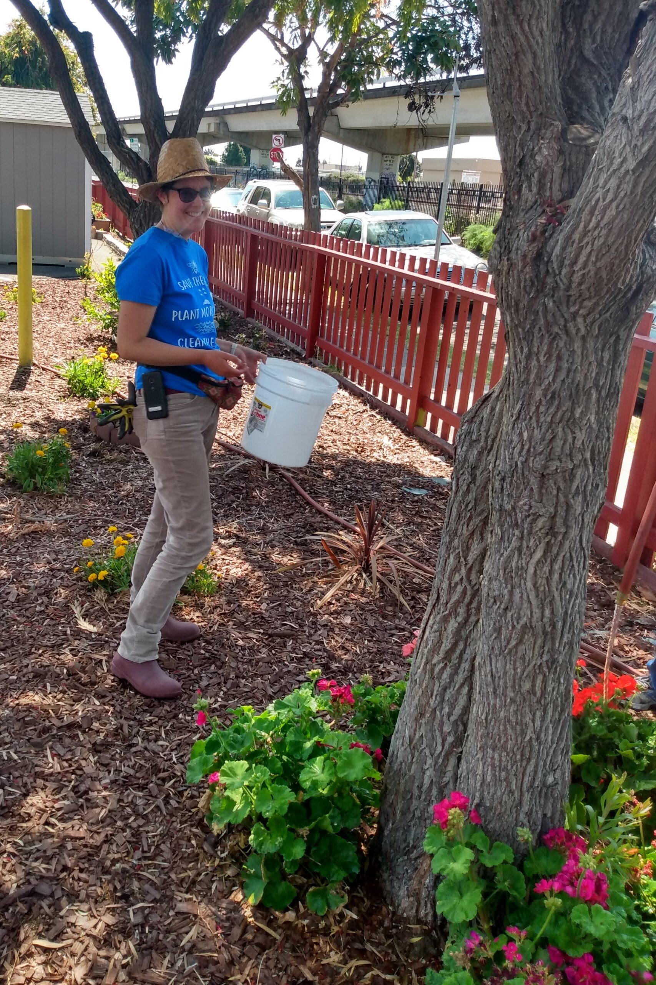
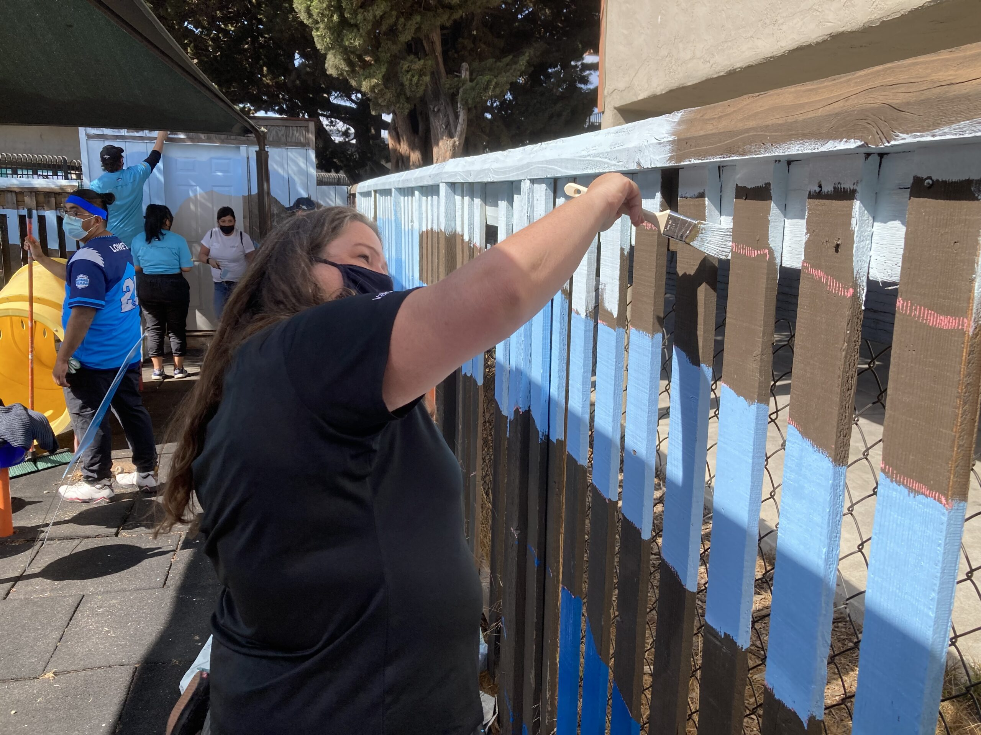
A quick tour of GRIP
GARDEN
This outdoor space is meant to bring some nature into this urban corner, plus some cheer with flowers, trees, and a walkable path for reflection.
• The Lowes 100 Hometowns Home Team partnership with the NFL and former GRIP resident Najee Harris--now the star running back for the Pittsburg Steelers--painted our outside fence, installed landscaping and pathways, and plantings around the property.
• Our Richmond Love Your Block Program brought even MORE volunteers to maintain and beautify the space more
PLAYGROUND
GRIP is proud to have a safe place for our shelter children to play.
• The playful and fun seascape mural was painted by GRIP employees, Lowe’s volunteers, and community leaders
• The landing mats are padded so our little ones are safe from injuries.
• The equipment is age appropriate for our littlest residents who wouldn’t yet ride bikes on the sidewalks and need a place to practice their active skills in a controlled environment. We are actively working to upgrade the playground equipment now as it does wear out quickly, as you can imagine.
• The sunshades keep kids cool on hotter days while the walls provide safety and privacy, especially for when we have children who are the victims of domestic violence
PANTRY
You’ve donated soaps, shampoo, razors, tampons, pads, underwear, clean socks, and toothpaste. This is where those all go, providing much-needed toiletries and products to be handed out to whoever is in need. • Did you know GRIP can use duffel bags, sleeping bags, blankets and jackets? As it gets cooler, see if you have any luggage or warm items to bring by!

Slide 6
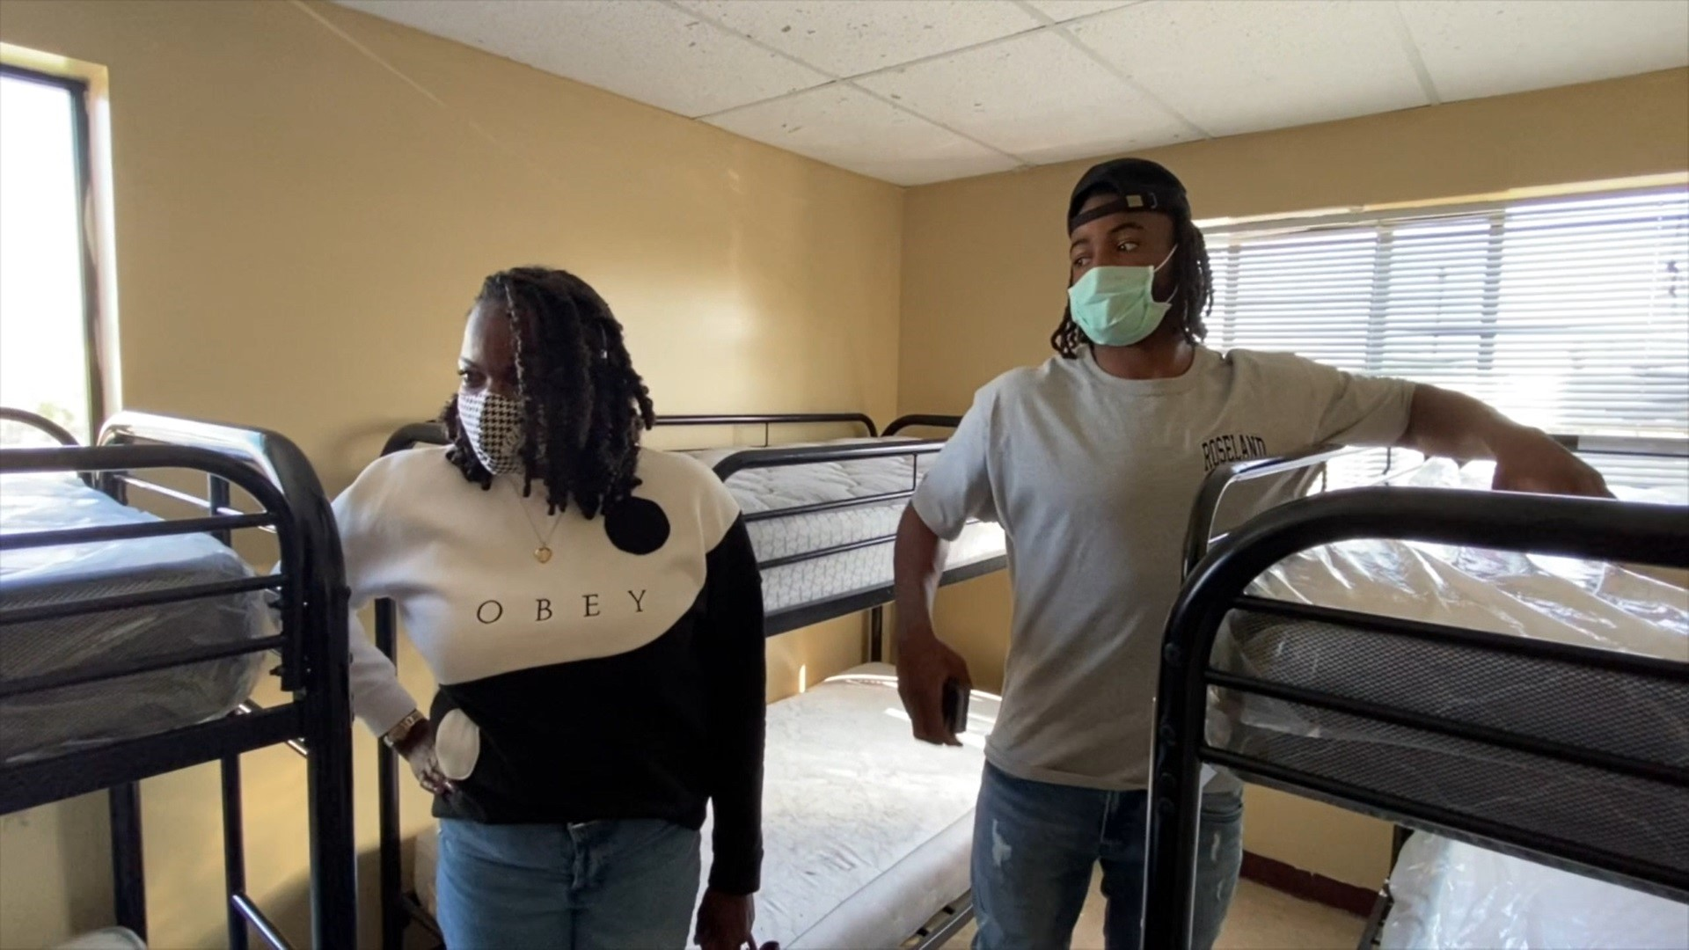
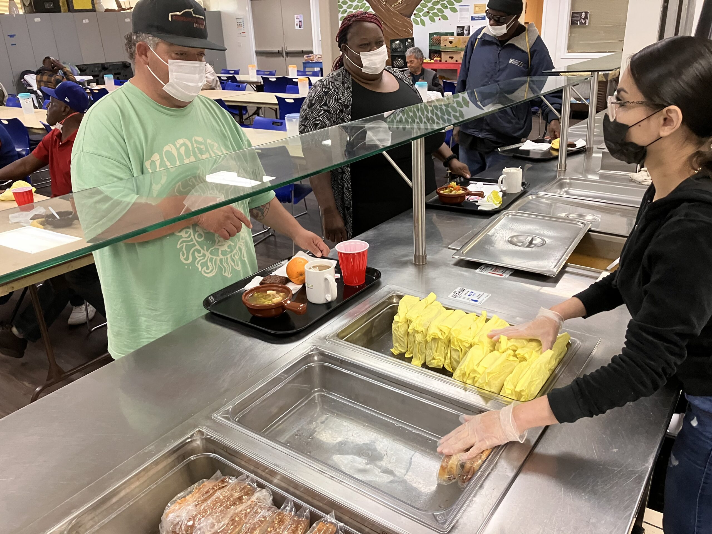
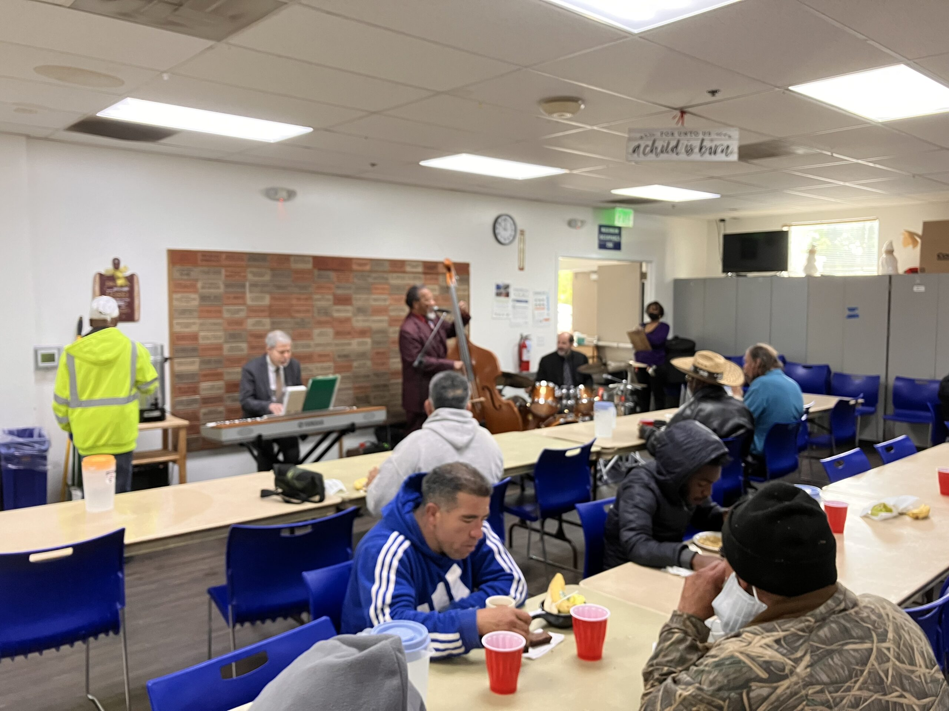
A quick tour of GRIP
SHELTER
This is the (temporary) home to up to 65 people, including families, newborns, infants, toddlers, single parents, couples, grandparents, teens, and young adults.
• District Council 16 Northern California Journeyman and Apprentice Finishing Trades Institute recently painted the center.
PHOTO: Najee Harris and his mother, Tianna Hicks tour the room where they and their family lived during their time without a home.
DINING ROOM
This is where it all began, with GRIP providing a hot soup lunch on foggy days back in 1966, as the Souper Center. This building was acquired in 1993 when GRIP could finally open a shelter to house people directly. We serve over 7500 meals each month during peak times.
KITCHEN
Here’s where donations of dropped off sandwiches go, along with giant pots of soup made by our staff fresh every day, and walk-in fridges full of fresh fruit and supplies both donated and sourced.
• We recently won a grant to upgrade our oven to a much more modern set up that can serve more meals faster, and with greater energy efficiency.
PANTRY
You’ve donated soaps, shampoo, razors, tampons, pads, underwear, clean socks, and toothpaste. This is where those all go, providing much-needed toiletries and products to be handed out to whoever is in need. • Did you know GRIP can use duffel bags, sleeping bags, blankets and jackets? As it gets cooler, see if you have any luggage or warm items to bring by!

Slide 7
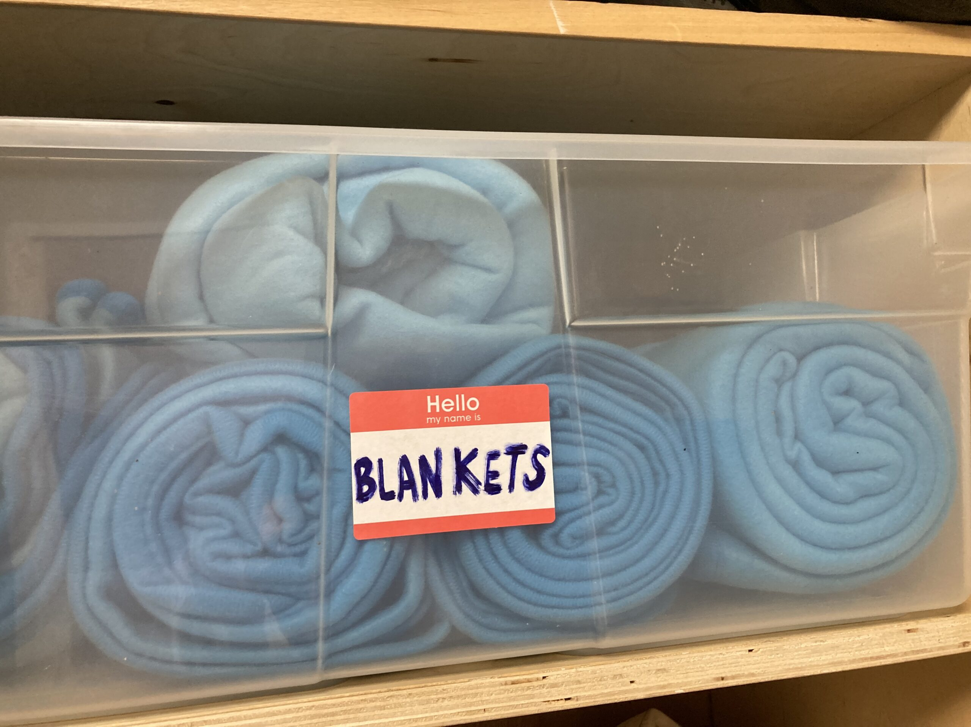
A quick tour of GRIP
PANTRY / RESOURCES
Supporters donate soaps, shampoo, razors, tampons, pads, underwear, clean socks, toothpaste, and so much more. This is where those all go, providing much-needed toiletries and products to be handed out to whoever is in need.
GRIP also passes out duffel bags, sleeping bags, blankets and jackets to support our clients.
SHOWERS
Nothing is better than a hot shower, especially when it’s cold out. It’s about health, hygiene, and the cathartic experience most of us enjoy every morning.
GRIP provides over 200 free showers to our clients each month, not even counting our shelter residents
LAUNCRY
Being without a home, or just struggling to get by means it can be very hard to get laundry done with no access to washers and dryers. It may be just difficult to budget for laundry even if you do have access when you’re struggling to just put food on the table. Having clean clothes, towels, and sheets is not just about hygiene. It also is important for job interviews and self-esteem.

Slide 8
Media Coverage
LOWE’s & Najee Harris: https://corporate.lowes.com/newsroom/stories/serving-communities/lowes-help-najee-harris-gives-back-homeless-shelter-where-he-once-lived
Najee Harris: https://abc7news.com/nfl-draft-najee-harris-richmond-homeless-shelter-antioch-high/10561291/
ESPN: https://www.espn.com/nfl/story/_/id/32555173/how-steelers-najee-harris-family-helping-homeless-shelter-where-once-lived
New Director: https://richmondstandard.com/richmond/2022/08/05/grip-announces-new-executive-director/
KQED: https://www.kqed.org/news/11740749/richmond-homeless-on-the-move-again-after-city-clears-large-tent-encampment

Slide 9
HARMONY WALK
Now in its 38th year (2024), the Harmony Walk brings together the community., GRIP clients and staff, local politicians, community leaders, faith groups, volunteers, and dignitaries to celebrate the work of GRIP in the highest profile public event all year.
The walk is both a fundraiser and a community event to share the great work by GRIP’s volunteers and staff.
Prior years have included a 5K fun run around the community, starting and ending in Nicholl Park on MacDonald Avenue in Richmond. The walk is usually held in October.
Sponsors often include Chevron, Mechanic’s Bank, Sims Metal Recycling, East Bay MUD, and Kaiser Permanente. In many years, runners got sponsors for themselves or a team. In 2022, the walk was shifted to a simpler model with a registration including a T-shirt and run registration to cover the fees individually.
In 2023, the Harmony Walk showcased an even fuller range of some of Richmond’s (and the broader East Bay’s) best businesses, community-based organizations, and more. Those who come to the park for the festivities will be encouraged to bring picnic blankets and chairs and to kick back, relax, and enjoy the music, guest speakers, food, the vendor booths, kids’ activities, and the raffle drawing. Of course, it wouldn’t be the Harmony Walk without a walk of some sort; attendees will have the option to participate in a short, 1-mile-or-so walk from Nicholl Park down to the GRIP shelter and back. There, walkers will have the opportunity, like last year, to step inside and learn more about the day-to-day, on-the-ground work that GRIP staff do to keep community members housed and fed.
In 2024, the Harmony Walk is shifting to a “Harmony Walk in the Park” theme, with more of a picnic feel.
Media-ready images available

Slide 10
SPONSORSHIP OPPORTUNITIES
Donation of goods and services: GRIP is always in need of toiletries, new and used clothing, duffle bags, blankets, sleeping bags, jackets, and food.
Donation of time: GRIP is supported by 41 faith groups in the community. If your group would like to volunteer, please contact the GRIP office.
Donation of money: Corporate donations, program sponsorships, and facility sponsorships are coordinated with the executive director and the board. Please reach out via phone or email.

Slide 11
BOARD OF DIRECTORS
The board consists of up to 15 community leaders serving a 3-year term. Each donates or raises $500 and participates in committee work and monthly meetings to manage the finances and strategic direction of GRIP. The Executive Director is a full-time staff member who reports to the board.

Slide 12
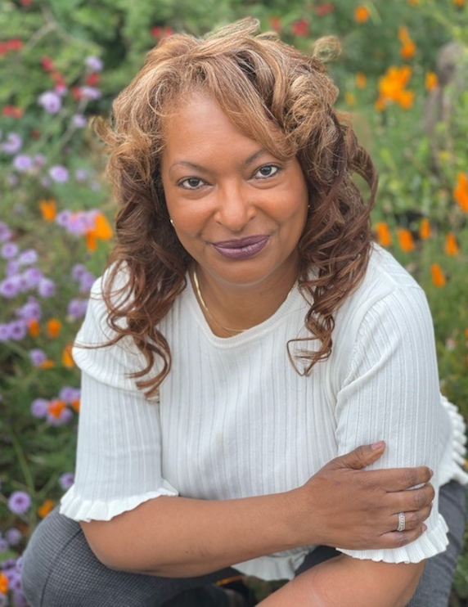
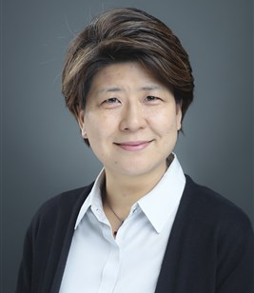
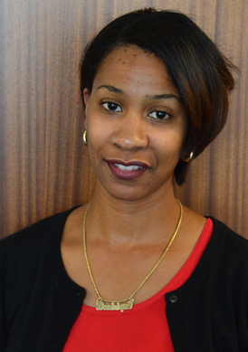
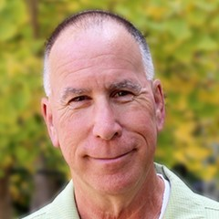
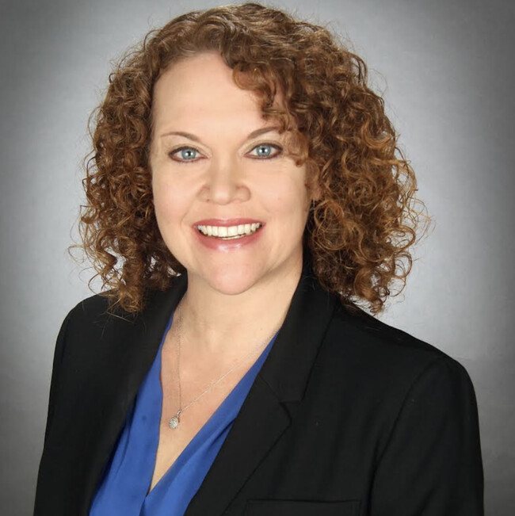
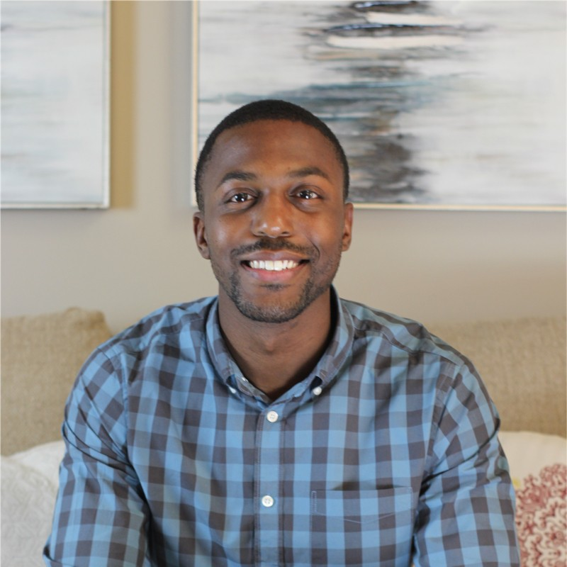
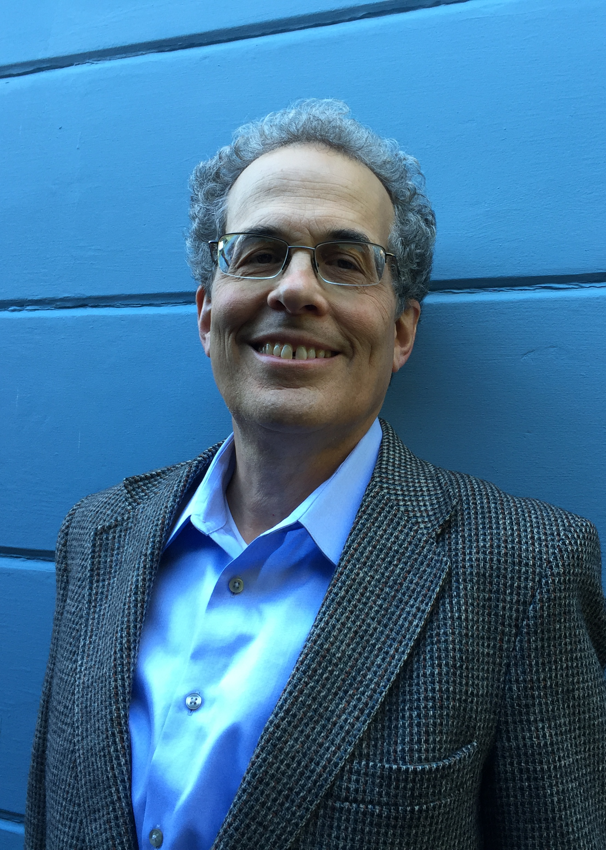
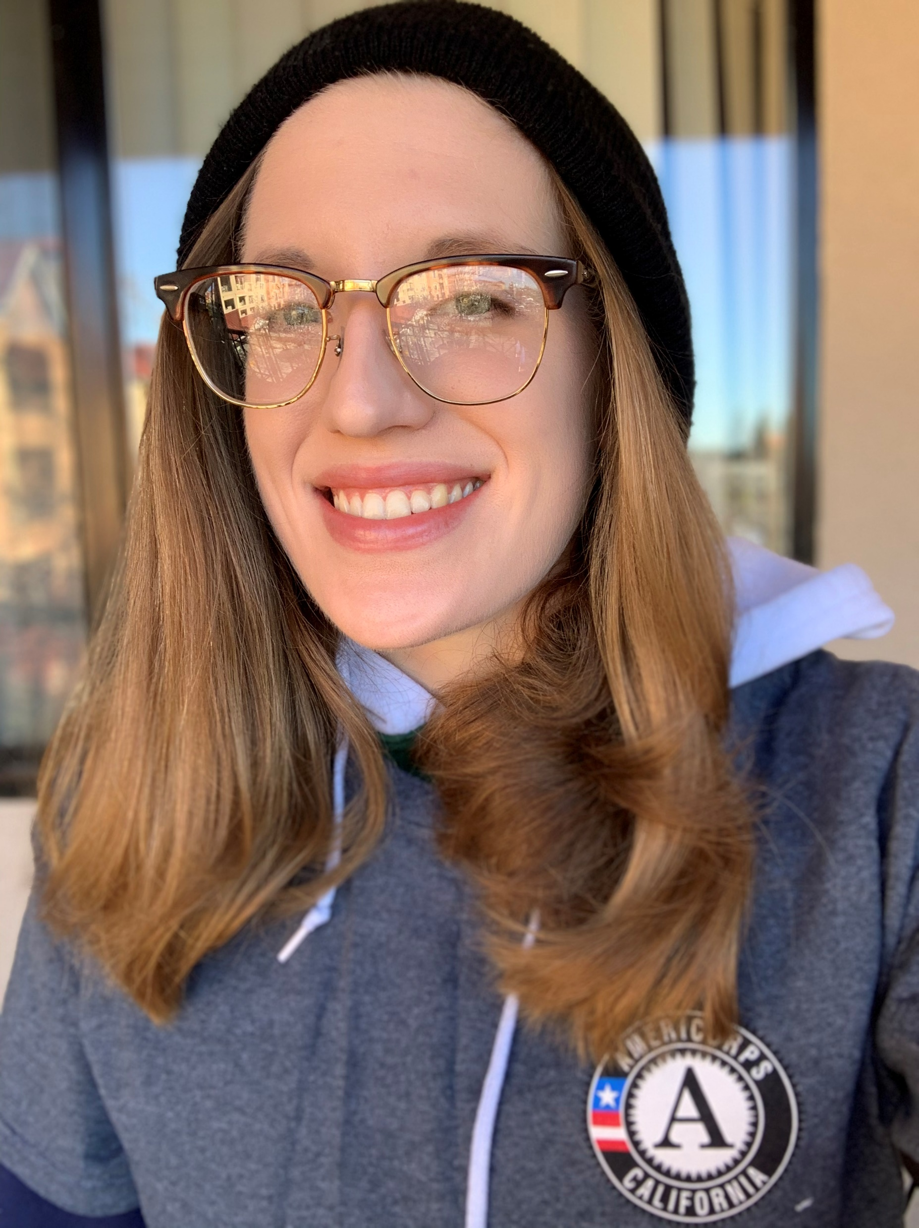
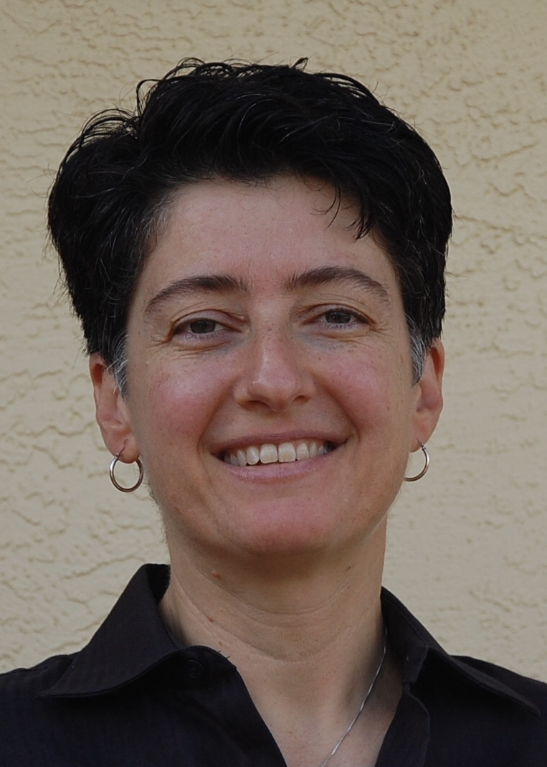
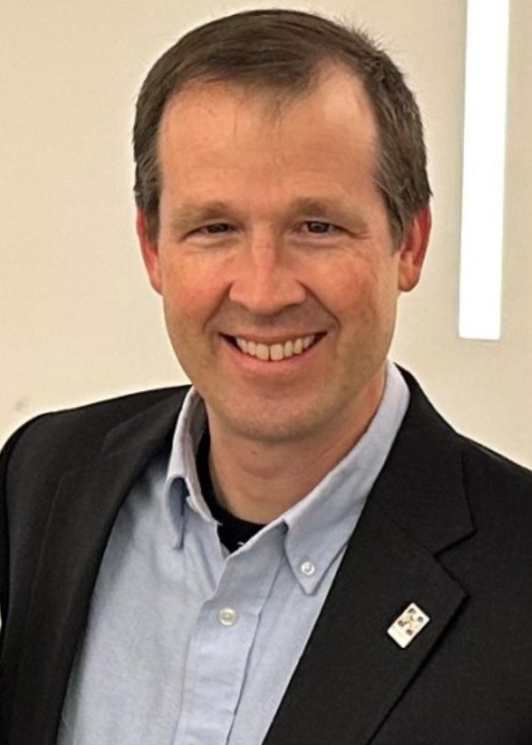
Board of Directors
Maria Costen
Eun-Joo (E.J.) Myung
Dominique
Roache-Green
Dean Kertesz
Ruthie Abelson Olivas
Patrick Sanders
Alan Marks
Jilly de la Torre
Ladie Malek
Brandon Mercer

Slide 13
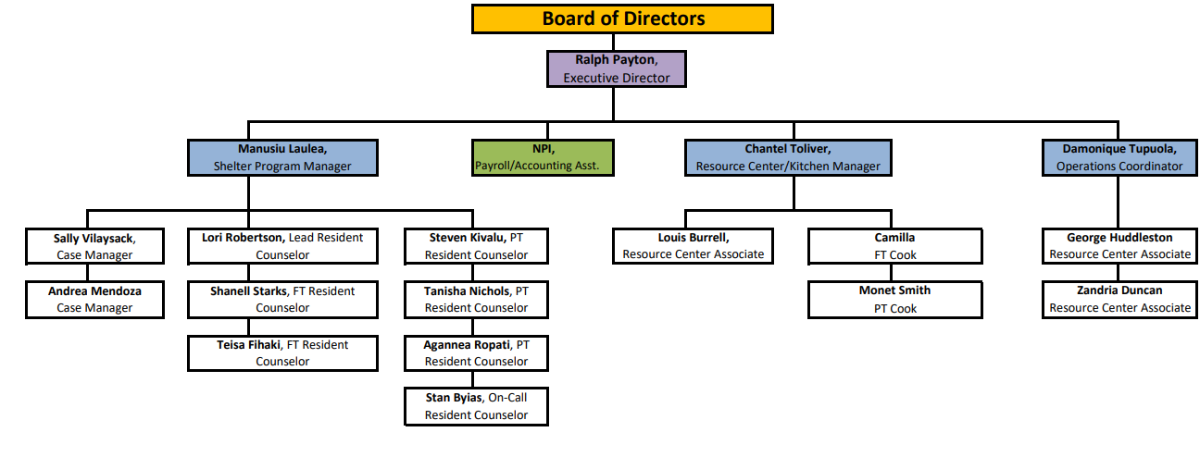
STAFF

Slide 14
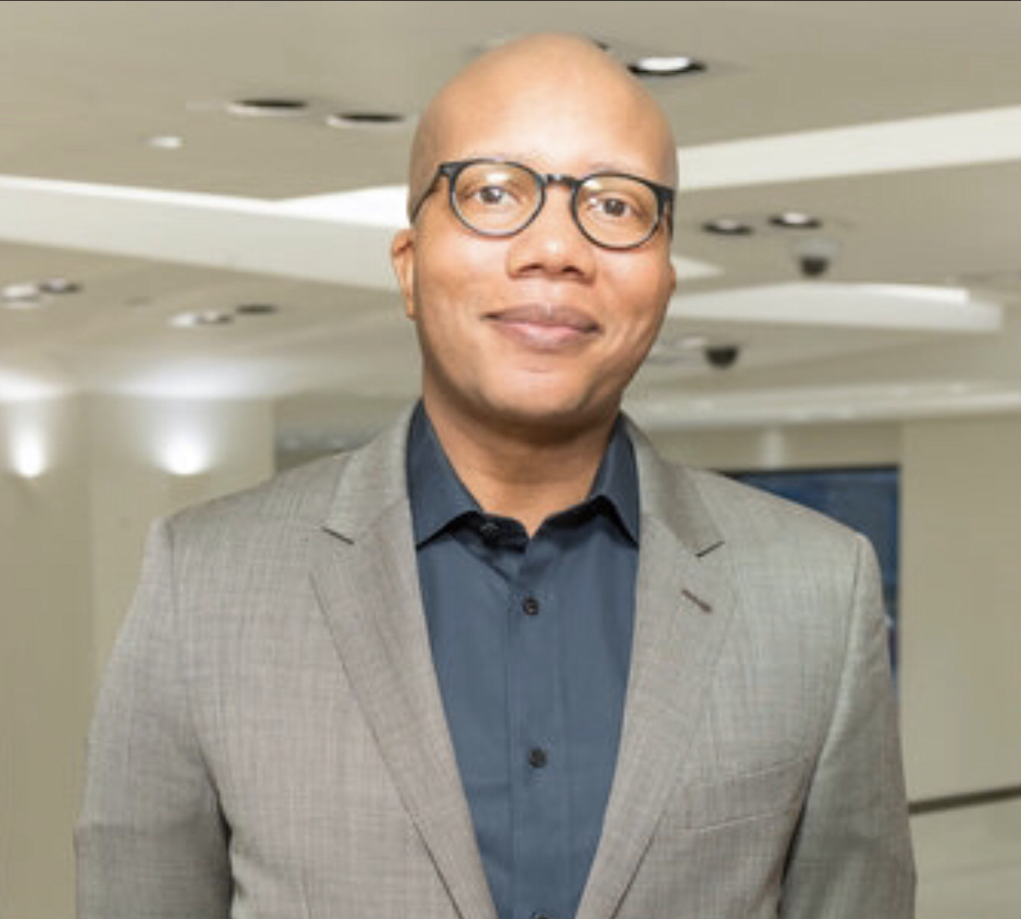
Ralph Payton Executive Director
Ralph Payton‘s commitment to social justice and underserved communities spans a career of more than 20 years directing nonprofit human service programs across the country. Prior to joining the team at GRIP, he was the Chief Executive Officer at Hunters Point Family, an organization that works to enrich the lives of youth in San Francisco’s Bayview/Hunters Point communities. From 2015-2018, Ralph was the Executive Director at Raphael House, which operates San Francisco’s largest shelter for families experiencing homelessness. He has worked with individuals and families experiencing homelessness in New York City and Miami before moving to San Francisco in 2011. He started his career as a social justice advocate in Florida where he was a clinical therapist for several years before switching career paths to join the efforts helping our unhoused neighbors and community members.

Slide 15
Manusiu T. Laulea Shelter Program Manager
My name is Manusiu Tuivailala Laulea. I am the Family Shelter Manager at the Greater Richmond Interfaith Program. I have been with GRIP for over 17 years. I am passionate about creating positive change in my community and helping people in need. My work focuses on providing services to families experiencing homelessness, such as housing, employment assistance, and case management. I also manage the day-to-day operations of our care center, which includes providing meals, hygiene products, clothing, and other basic needs for those who come to us for help. It is an honor to be able to make a difference in people's lives and I take pride in the work that I do every day.

Slide 16
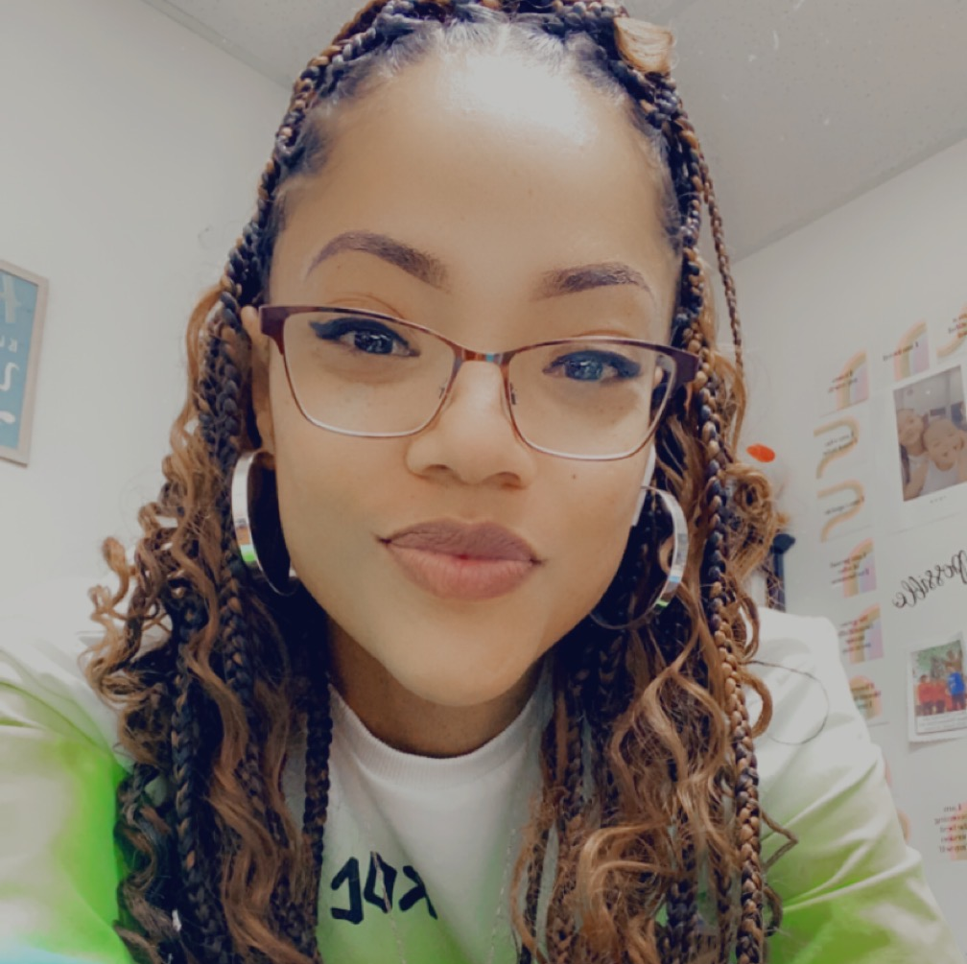
‘Damo’ Damonique Tupuola Operations Coordinator
My name is Damonique (Damo) Tupuola and I am the operations coordinator here at GRIP. I started with GRIP in 2021, as a resident counselor for our Project Room Key program in Richmond, CA. Since then, I have been promoted to my current position as operations coordinator where I oversee facility operations and ensure each department is equipped with the tools and resources they need, while ensuring the facility runs smoothly as a whole. I am currently enrolled at Contra Costa College pursuing my bachelor’s degree in business administration and also studying to become a licensed real estate agent in California. As a native resident of Richmond, it means so much to me to be able to serve my city and give back to my community especially when I have experienced homelessness on several occasions.

Slide 17
GRIP THANKS YOU FOR YOUR SUPPORT
GRIP provides a safe & nourishing place that helps transform those who are unsheltered and in need move toward self-sufficiency.
www.GRIPCARES.org
165 22nd Street, Richmond, California 94801
(510) 233-2141
info@gripcommunity.org

